Slide 1
Introduction to Python
Techtonic

Slide 2
Course Overview
Title : Introduction to Python
Duration : 2 hours
Modules : 4 modules
Practices : 4practices
Quizzes : 4 quizzes
Material : Video lectures, Code example, Slides

Slide 3
Learning Objective and Course outcome
Different between natural language and programming language
Basic understanding of Python Programming language
Hands-on Assignments and Quizzes

Slide 4
Learning Modules
What is Python?
Installing Python
Sublime text download
Your First Python Program
What is Variable
Numeric Expression
Type Conversions
Input Function and Converting User Input
Comparison Operators
One-way Decisions(if)
Two-way Decisions(if-else)
Multi-way Decisions(if-elif-else) and Nested way
While Loop
Infinite Loop
Breaking out of the Loop
For Loop

Slide 5
Introduction to Python
Module - 1

Slide 6
Module - 1
01
02
03
04
What is Python?
Installing Python
Sublime Text Download
Your First Python Program

Slide 7
What is Python?
Python is Programming Language
Python is a language that computer understand.
It's like teaching your computer to do things by giving it simple, human-like instructions.
You can use it to make games, websites, and lots of other cool stuff.

Slide 8
Installing Python
Go to the official Python website
www.python.org

Slide 9
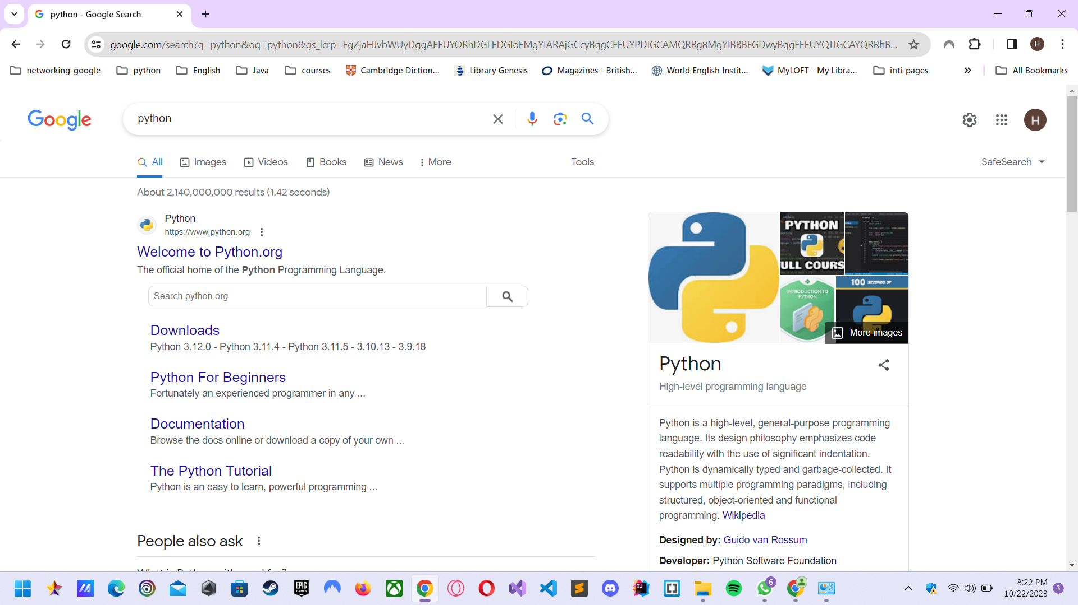
Go to Python website

Slide 10
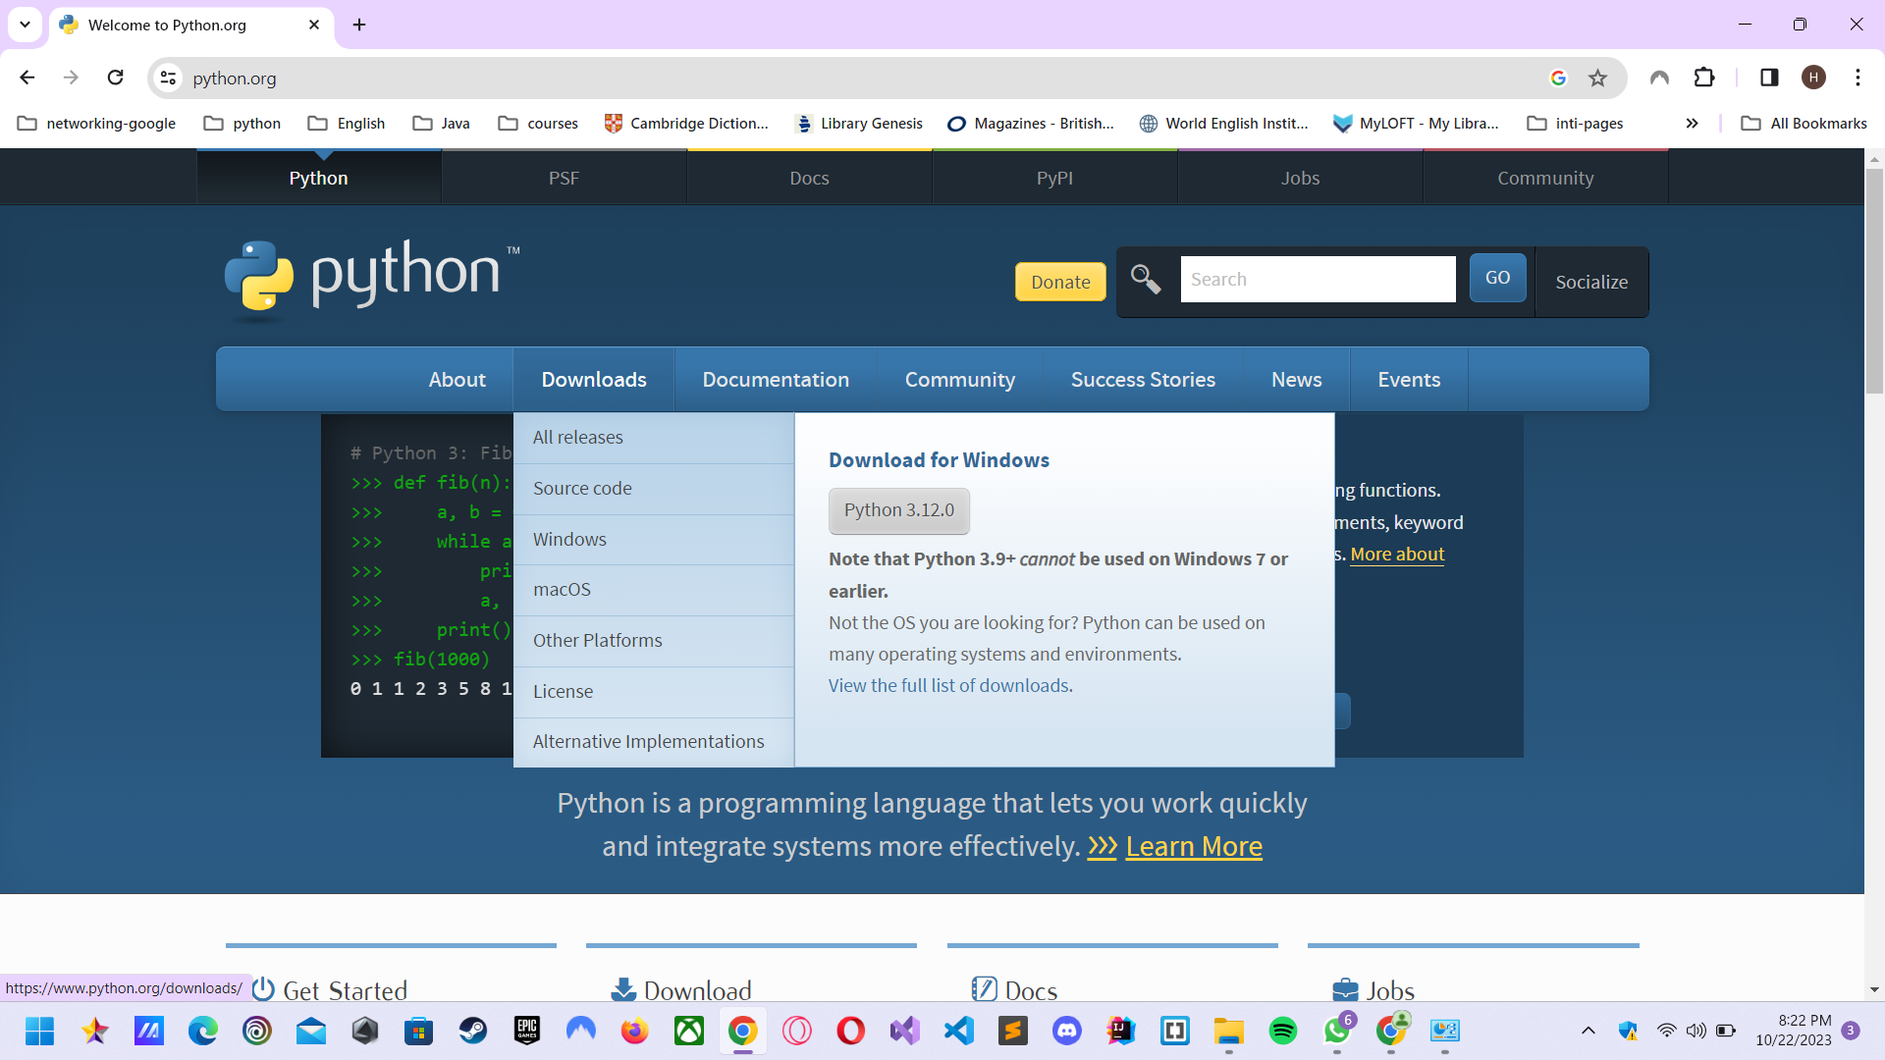
Download latest version of Python

Slide 11
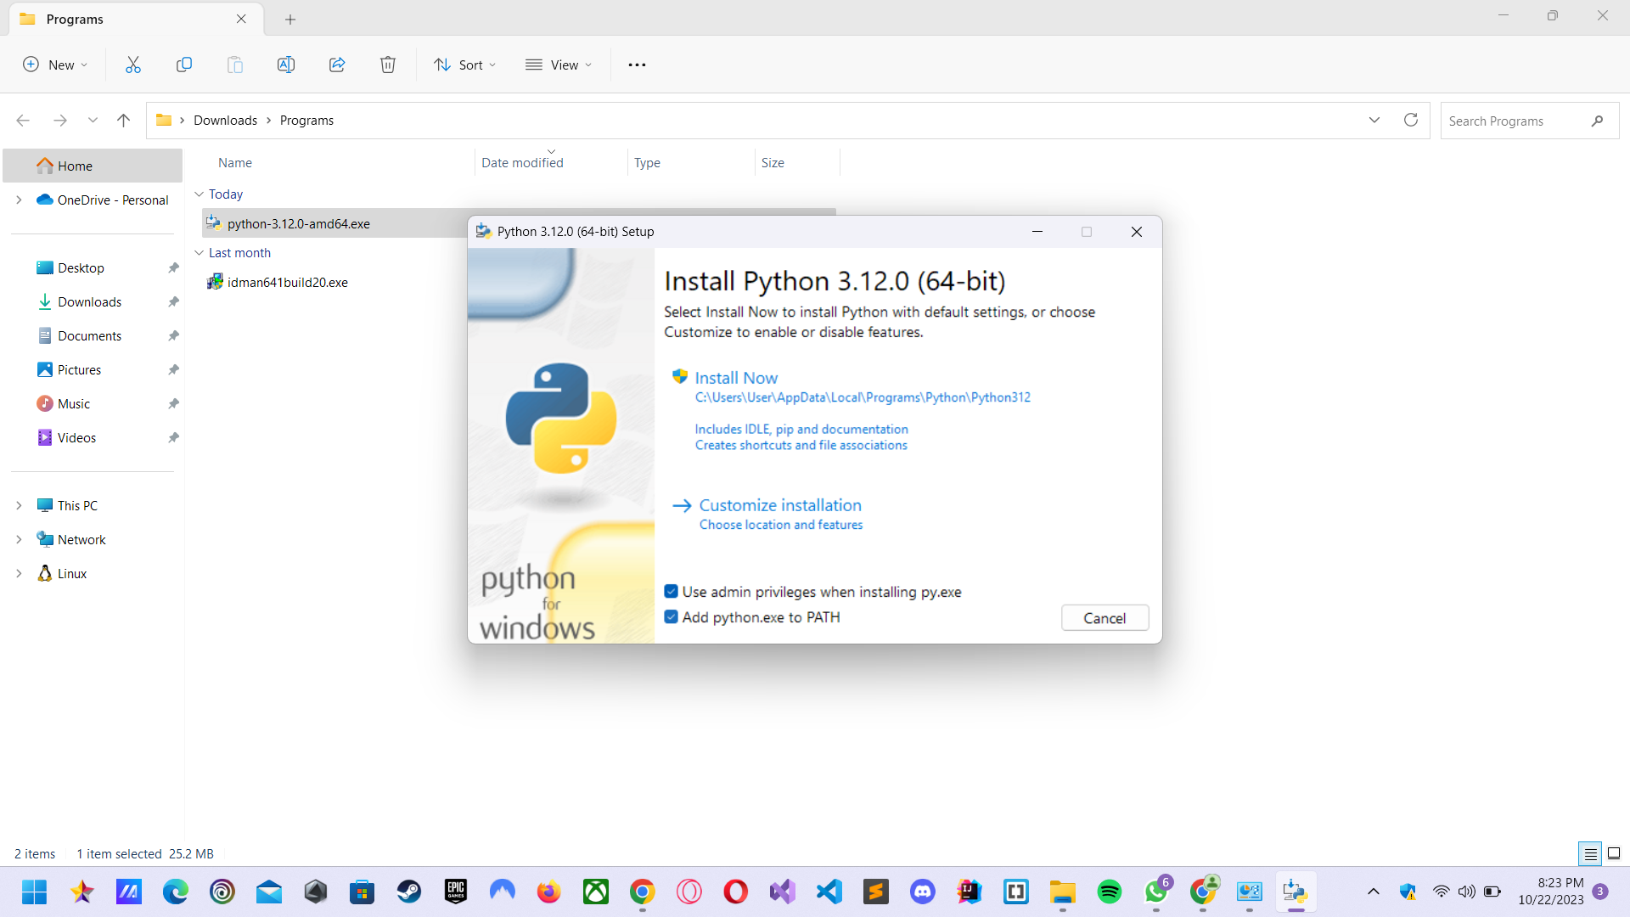
Installing latest version of Python

Slide 12
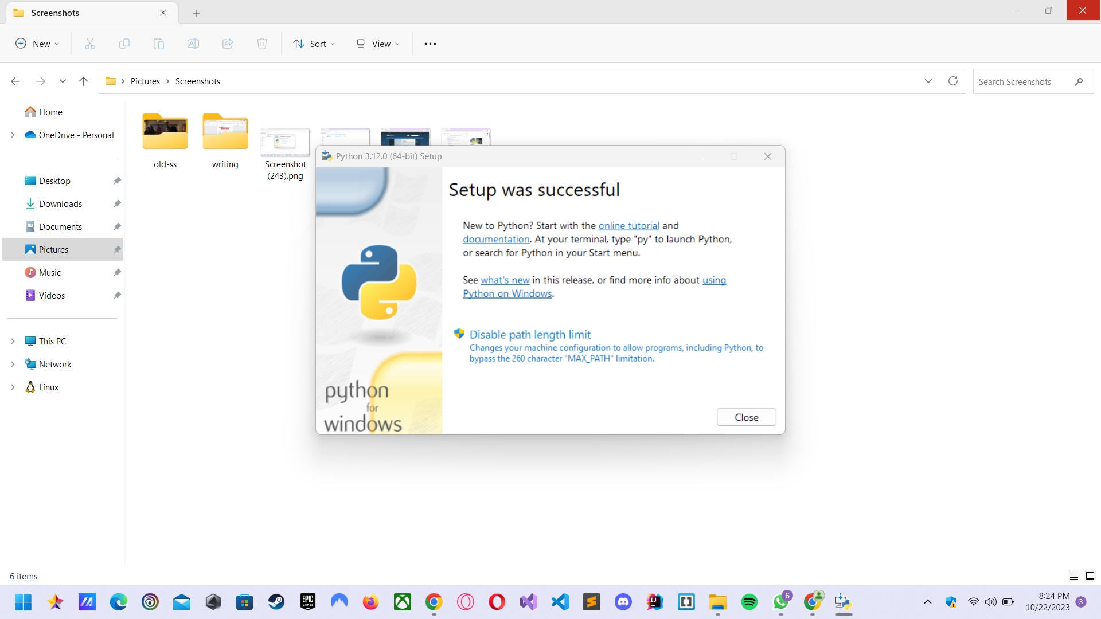
Installation complete

Slide 13
Module - 1
01
02
03
04
What is Python?
Installing Python
Sublime Text Download
Your First Python Program

Slide 14
Download Sublime Text
https://www.sublimetext.com/
Go to this link and download sublime text editor

Slide 15
Your first python Program
print(“Hello Python!!!”)
Output:
Hello Python!!!

Slide 16
Module - 2
01
02
03
04
Variables
Numeric Expression
Type Conversions
Input Function and Converting User Input

Slide 17
Variables
A variable is a named place in the memory where a programmer can store data and later retrieve the data using the variable “name”
How to create a variable?
variable name = data(value that you want to store)
X = 12
Age = 20
Name = “Jerry”

Slide 18
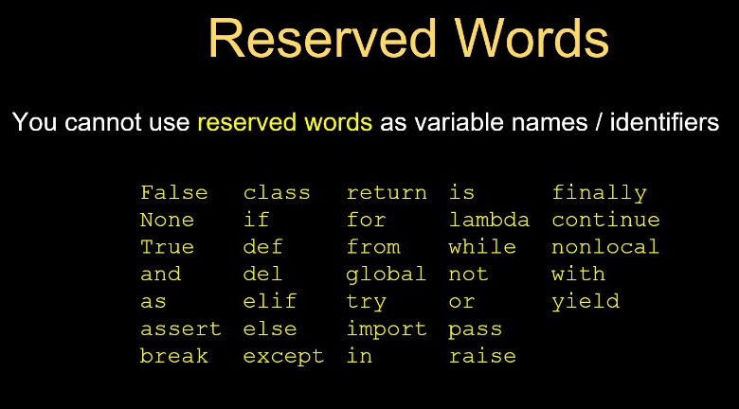
Reserved words to avoid when giving a variable name

Slide 19
Data types
Numeric Data Types: integer(int), floating point numbers these are common numeric data type.
String Data Type(str): represent sequence of characters
Boolean Data Type(bool): represent True or False
Collection Data Types: list, tuple, dict, set

Slide 20
Numeric Expression
Operator | Operation
+ | Addition
- | Subtraction
* | Multiplication
/ | Division
** | Power
% | Remainder
Symbols like +, -, *, and / to perform operations, such as addition or multiplication.

Slide 21
Type Conversions
Type conversion is like translating between different languages. In a computer program, it's when you change one kind of data (like numbers or text) into another kind so the program can understand and work with it. It's a way to make sure things fit together when you're writing code.
number = 42
text = str(number) # Converts the number to a string
print(text) # Output: "42" (as a string)

Slide 22
Input Function
In Python, the input() function is used to collect data or information entered by a user through the keyboard.
Here’s how it works
name= input(“Who are you?”)
print(“Hello”, name)

Slide 23
Converting User Input
If we want to read a number from the user, we must convert it form a string to a number using a type conversion function.
Here’s how it works
str_number= input(“enter number”)
int_number = int(str_number)

Slide 24
Module - 3
01
02
03
04
Comparsion Operators
One-way Decisions
(if statement)
Multi-way (if-elif-else)and nested way
Two-way Decisions
(if-else)

Slide 25
Comparison Operators
Python | Meaning
< | Less than
<= | Less than or Equal to
== | Equal to
>= | Greater than or Equal to
> | Greater than
!= | Not equal
Boolean expressions ask as question and produce a Yes or No result.
Boolean expressions using comparison operators evaluate to True / False or Yes / No

Slide 26
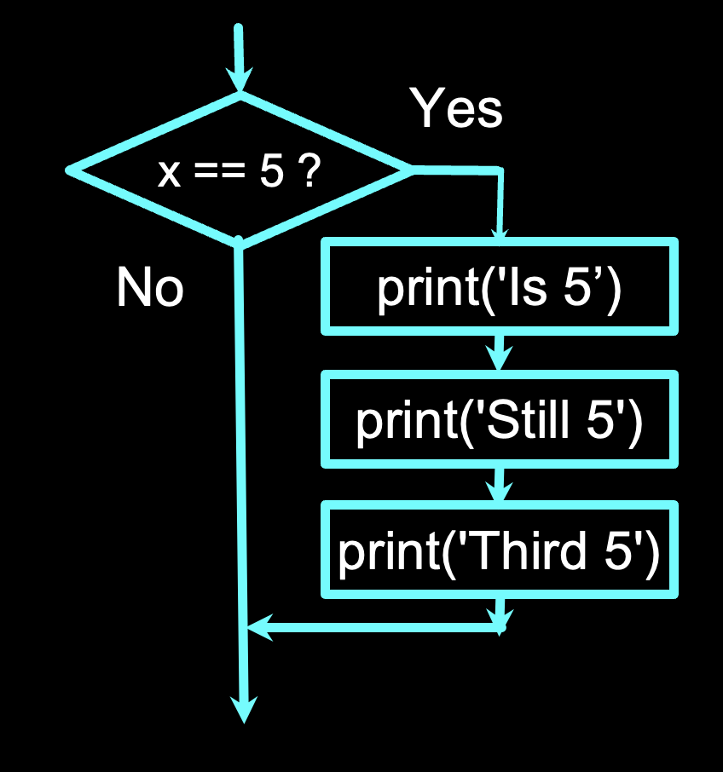
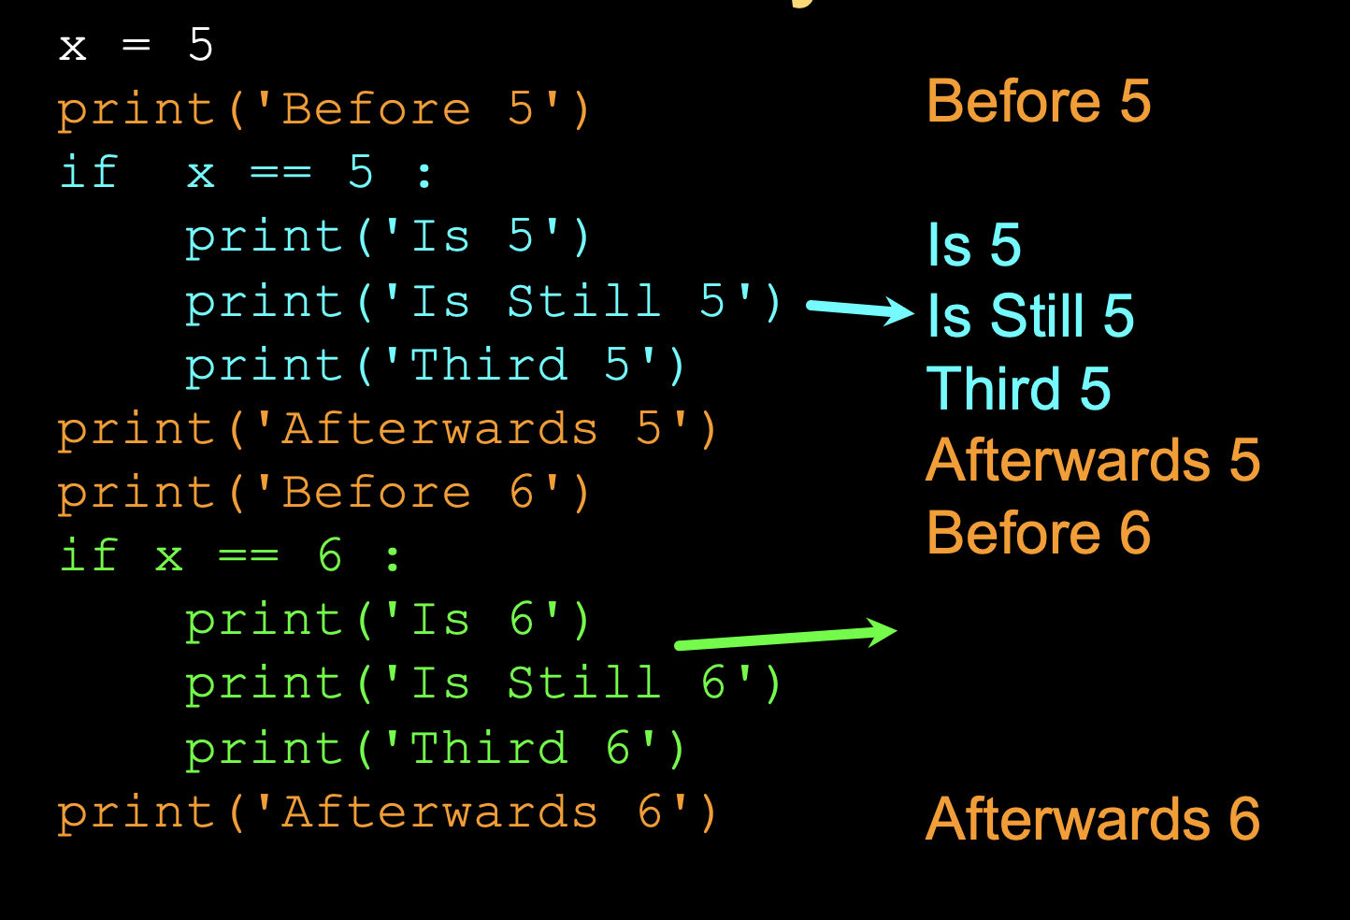
One-way Decisions

Slide 27
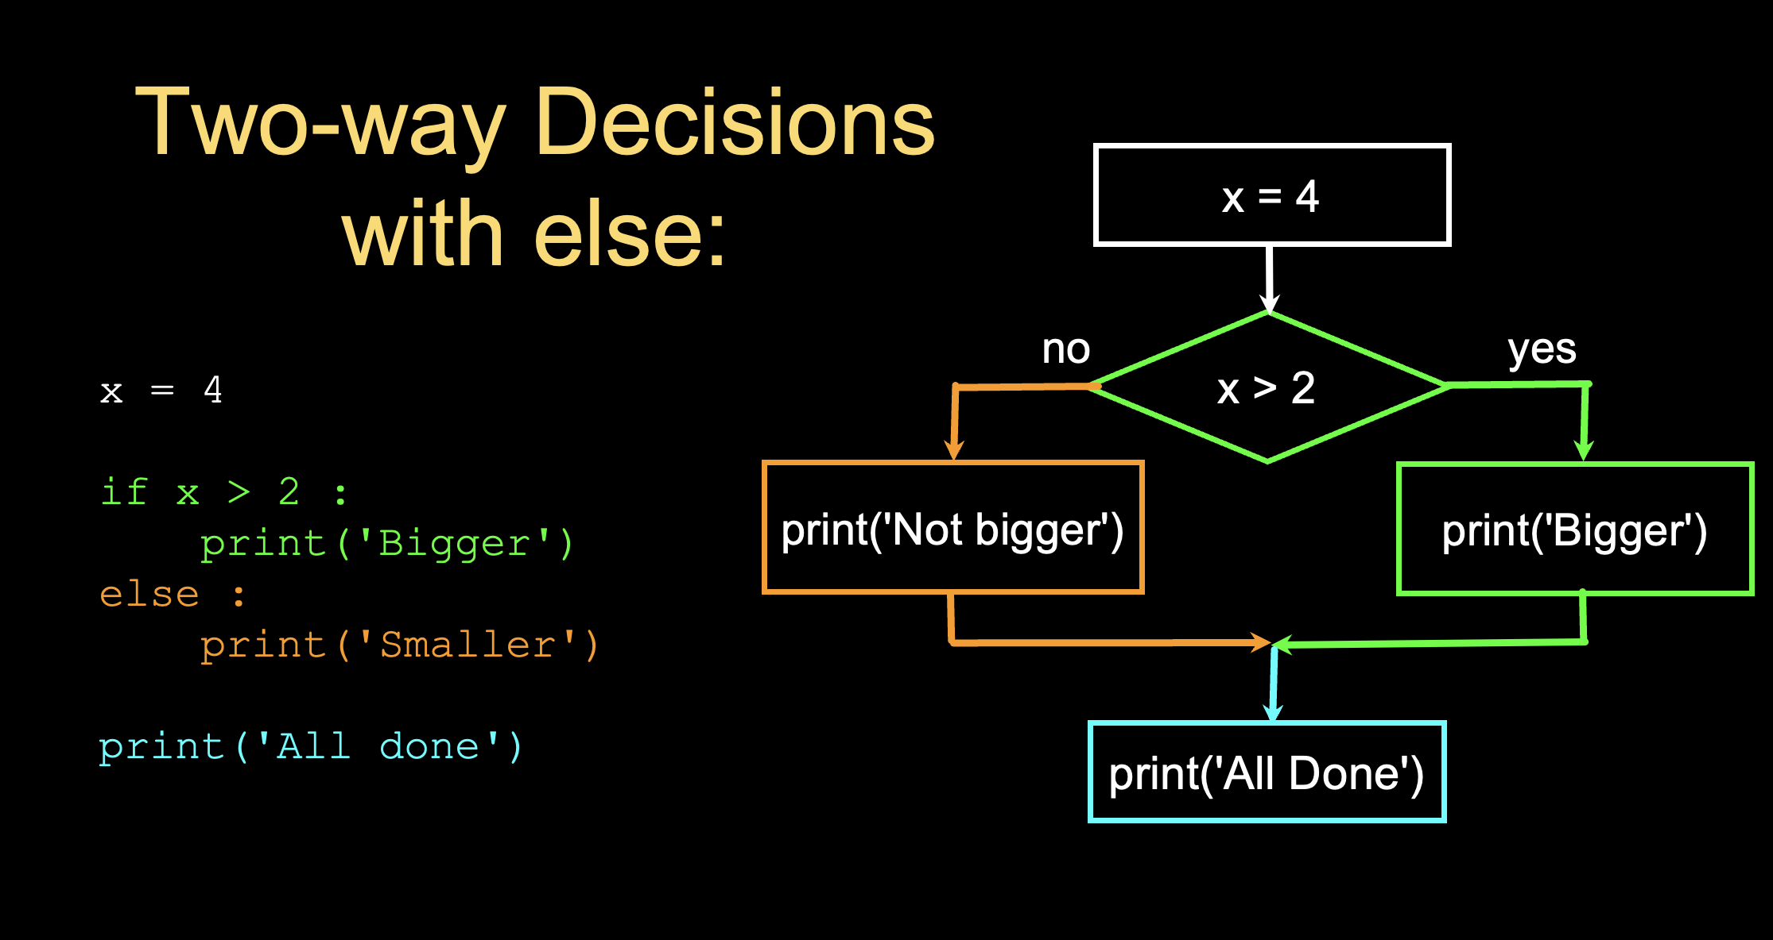
Two-way Decisions

Slide 28
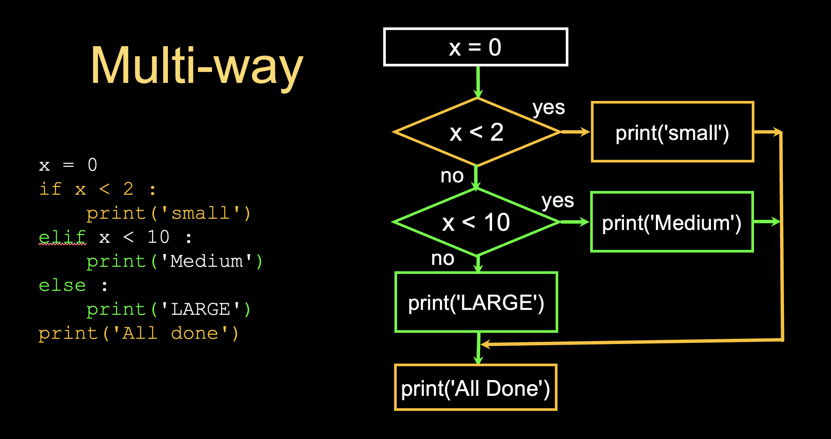
Multi-way Decisions

Slide 29
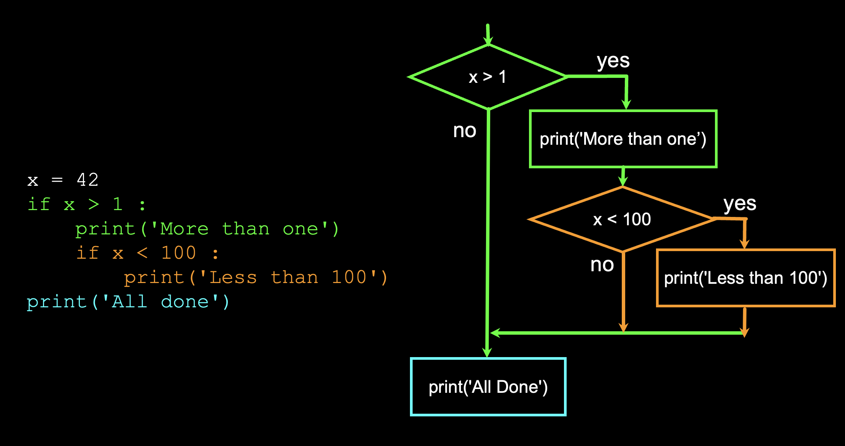
Nested-way

Slide 30
Module - 4
01
02
03
04
While Loop
An Infinite Loop
For Loop
Breaking out of the Loop

Slide 31
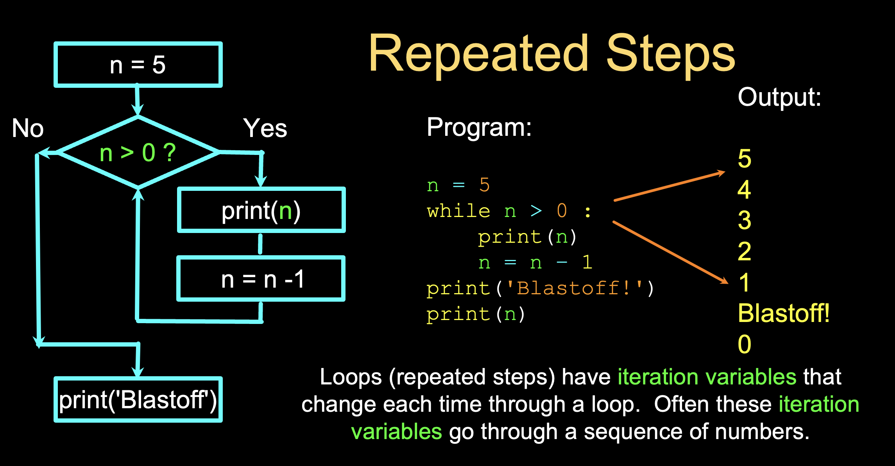
While Loop

Slide 32
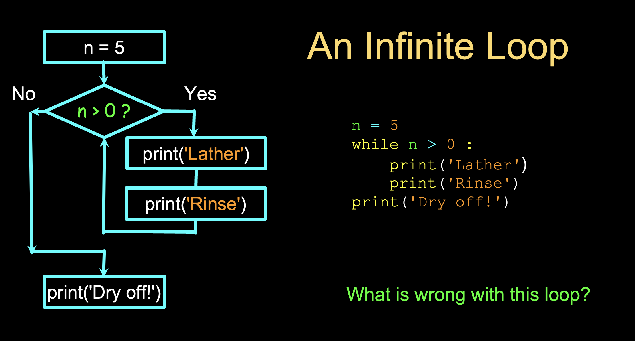
An Infinte Loop

Slide 33
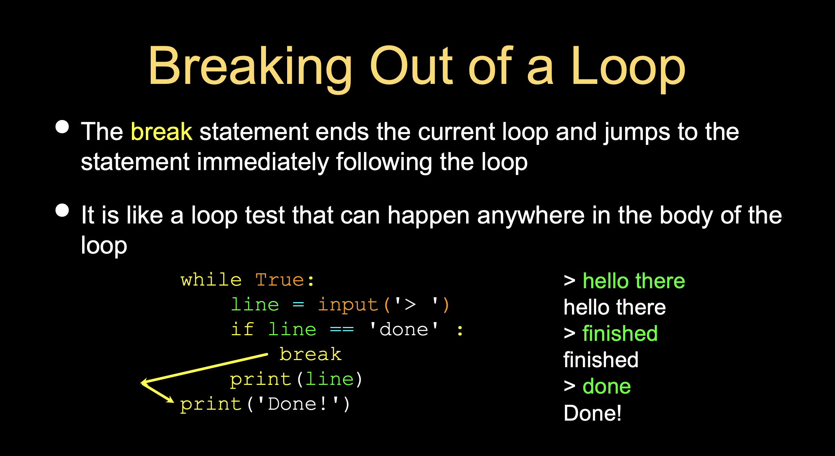
Breaking out of the Loop

Slide 34
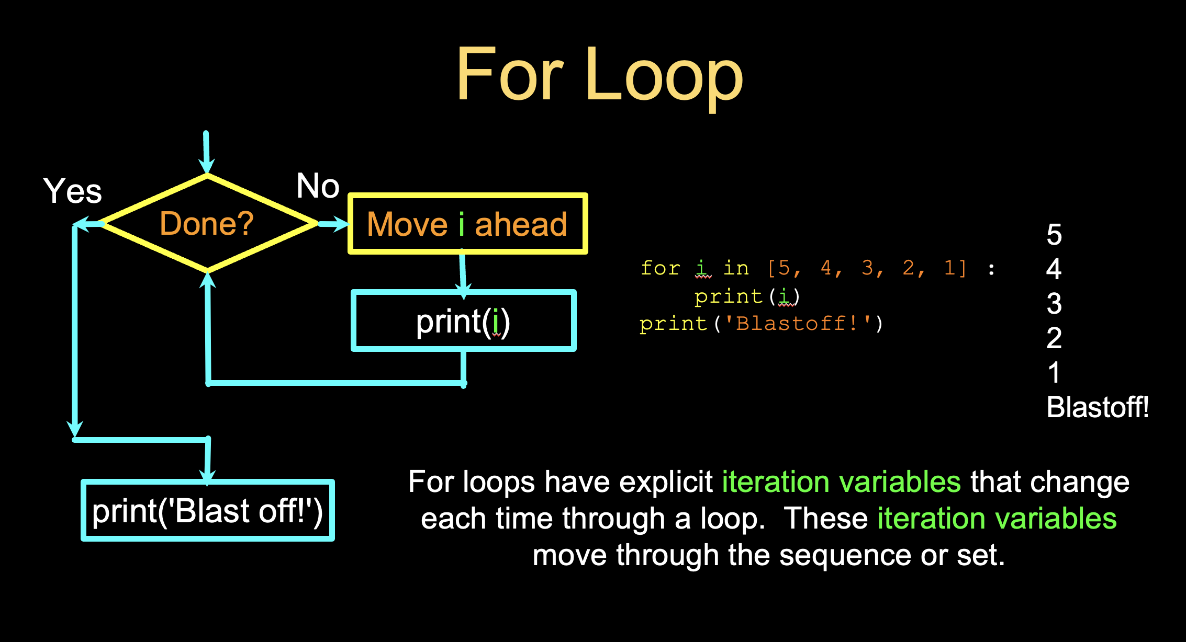
For Loop

